Slide 1
Proteomics Informatics –
Molecular signatures (Week 12)

Slide 2
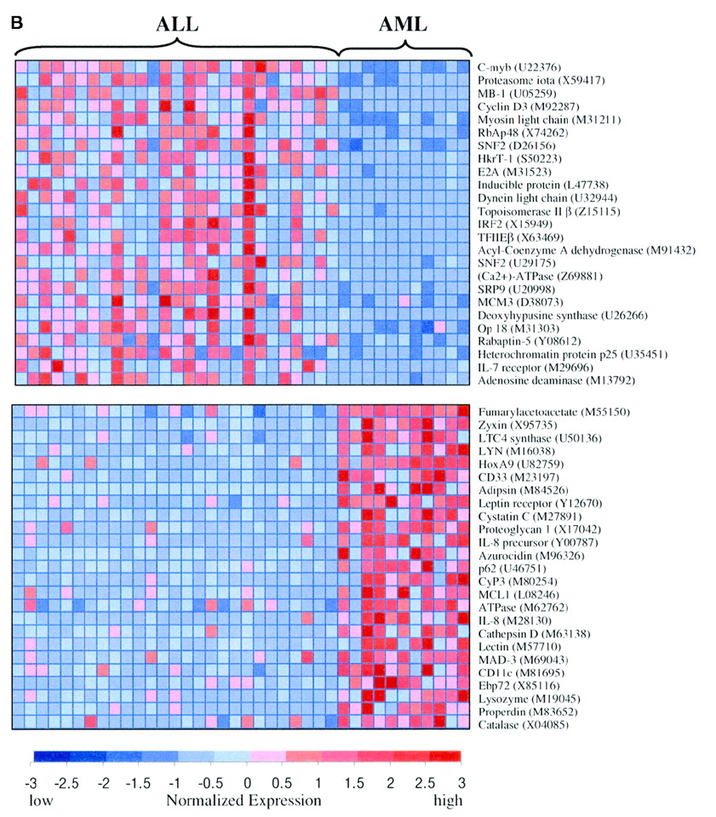
Definition of a molecular signature
A molecular signature is a computational or mathematical model that links high-dimensional molecular information to phenotype or other response variable of interest.
FDA calls them “in vitro
diagnostic multivariate assays”

Slide 3
Uses of molecular signatures
Models of disease phenotype/clinical outcome
Diagnosis
Prognosis, long-term disease management
Personalized treatment (drug selection, titration)
Biomarkers for diagnosis, or outcome prediction
Make the above tasks resource efficient, and easy to use in clinical practice
Discovery of structure & mechanisms (regulatory/interaction networks, pathways, sub-types)
Leads for potential new drug candidates

Slide 4
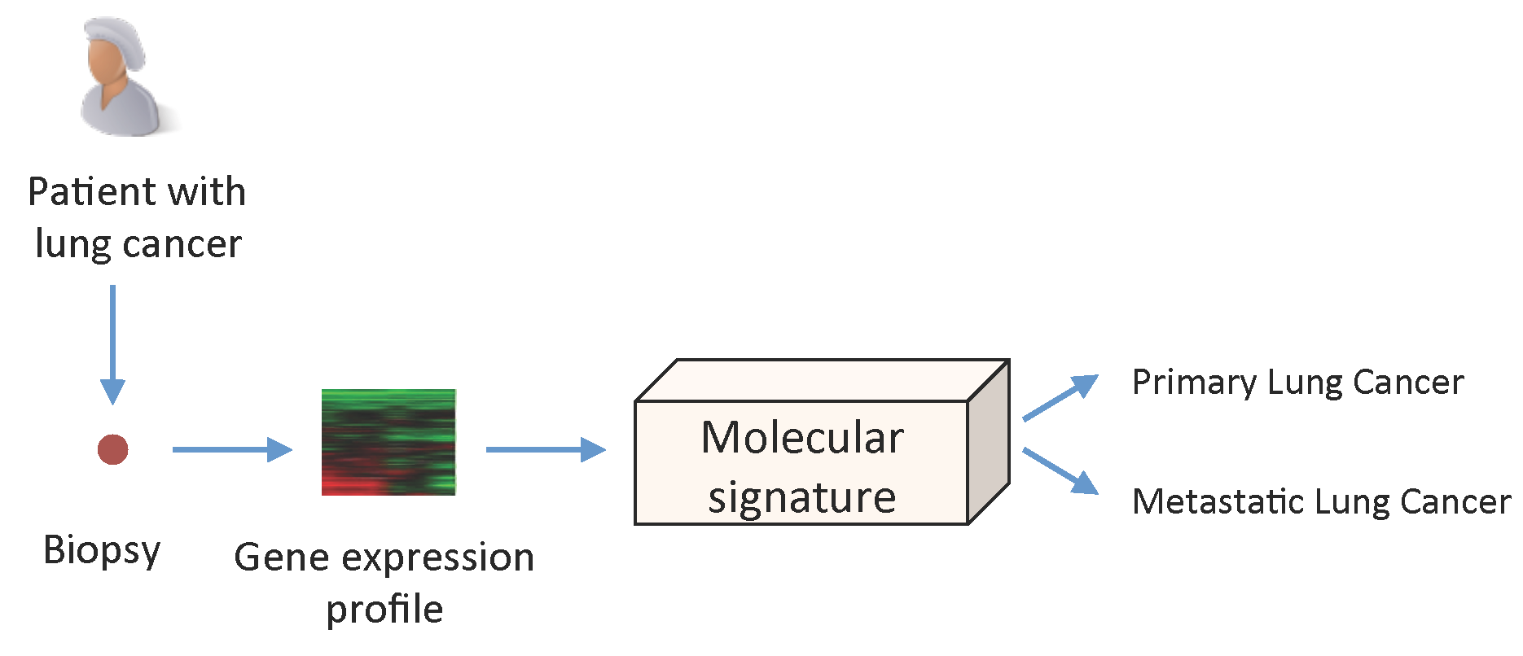
Example of a molecular signature

Slide 5
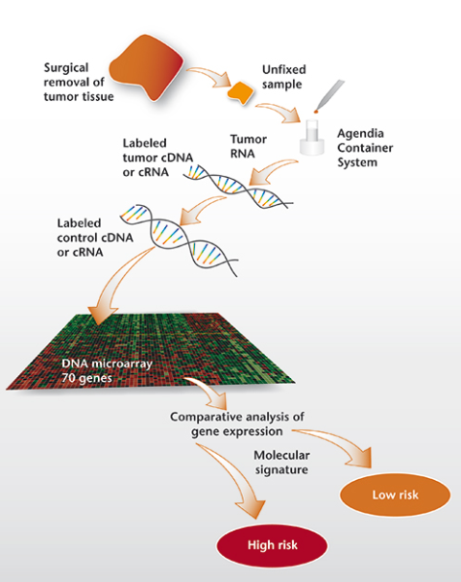
MammaPrint
• Developed by Agendia (www.agendia.com)
• 70-gene signature to stratify women with breast cancer that hasn’t spread into “low risk” and “high risk” for recurrence of the disease
• Independently validated in >1,000 patients
• So far performed >10,000 tests
• Cost of the test is ~$3,000
• In February, 2007 the FDA cleared the MammaPrint test for marketing in the U.S. for node negative women under 61 years of age with tumors of less than 5 cm.
• TIME Magazine’s 2007 “medical invention of the year”.

Slide 6
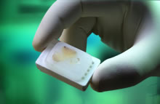
Oncotype DX Breast Cancer Assay
Developed by Genomic Health (www.genomichealth.com)
21-gene signature to predict whether a woman with localized, ER+ breast cancer is at risk of relapse
Independently validated in thousands of patients
So far performed >100,000 tests
Price of the test is $4,175
Not FDA approved but covered by most insurances including Medicare
Its sales in 2010 reached $170M and with a compound annual growth rate is projected to hit $300M by 2015.

Slide 7
Improved Survival and Cost Savings
In a 2005 economic analysis of recurrence in LN-,ER+ patients receiving tamoxifen, Hornberger et al. performed a cost-utility analysis using a decision analytic model. Using a model, recurrence Score result was predicted on average to increase quality-adjusted survival by 16.3 years and reduce overall costs by $155,128.
In a 2 million member plan, approximately 773 women are eligible for the test. If half receive the test, given the high and increasing cost of adjuvant chemotherapy, supportive care and management of adverse events, the use of the Oncotype DX assay is estimated to save approximately $1,930 per woman tested (given an aggregate 34% reduction in chemotherapy use).

Slide 8
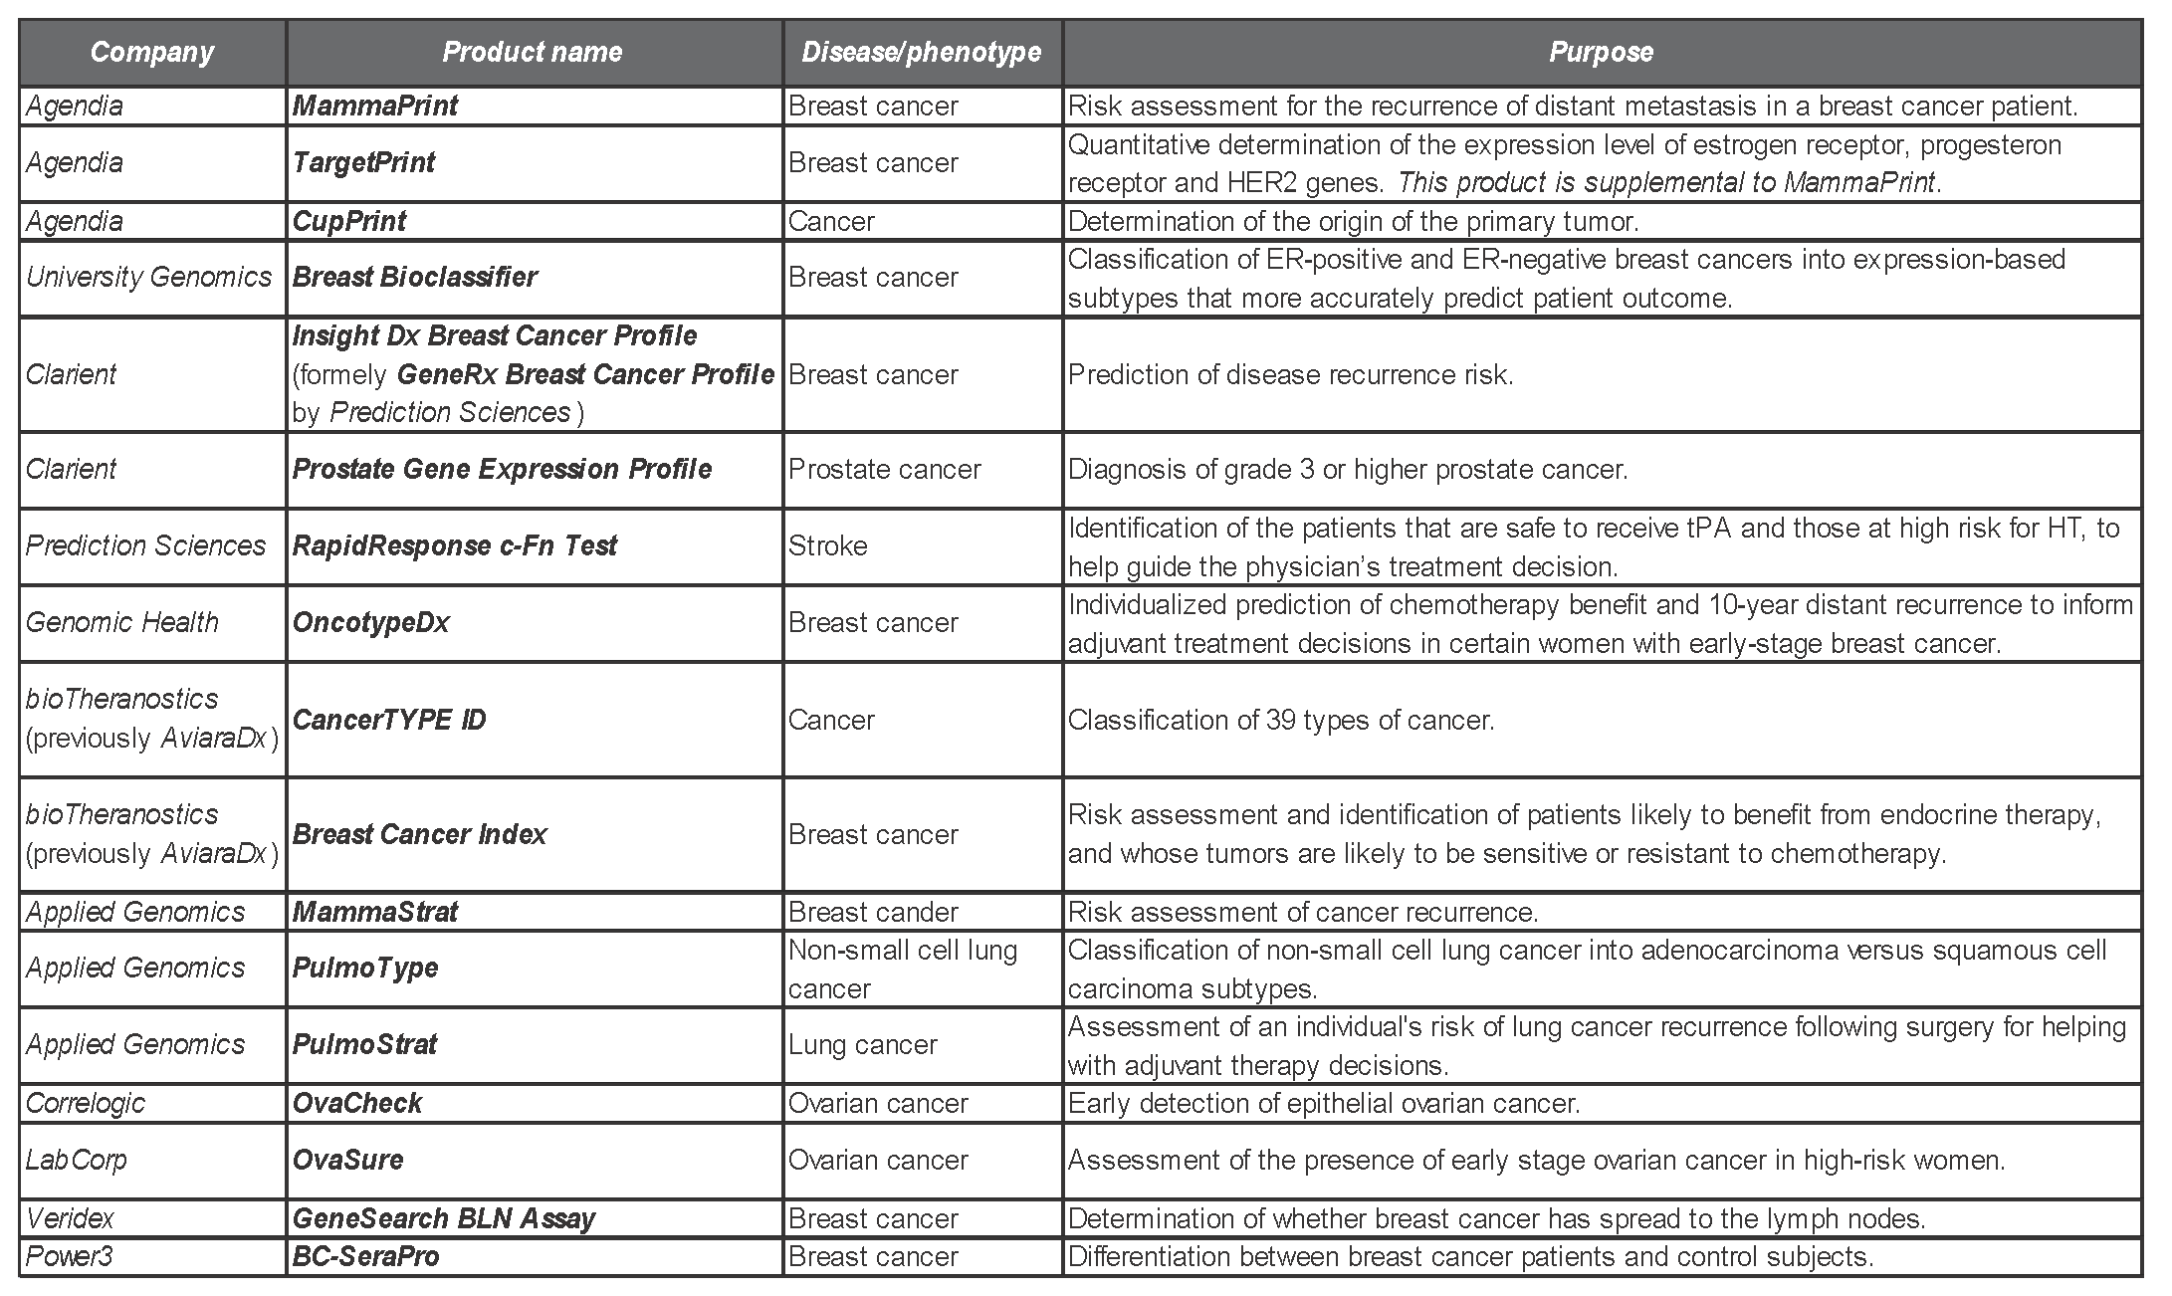
Molecular signatures on the market

Slide 9
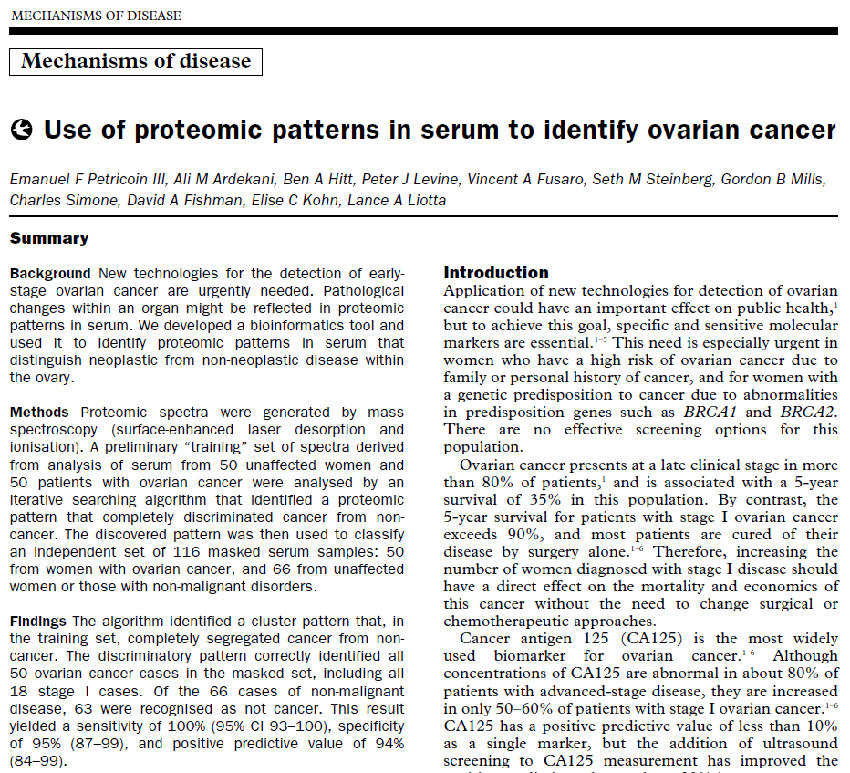
EF Petricoin III, AM Ardekani, BA Hitt, PJ Levine, VA Fusaro, SM Steinberg, GB Mills, C Simone, DA Fishman, EC Kohn, LA Liotta, "Use of proteomic patterns in serum to identify ovarian cancer", Lancet 359 (2002) 572–77

Slide 10
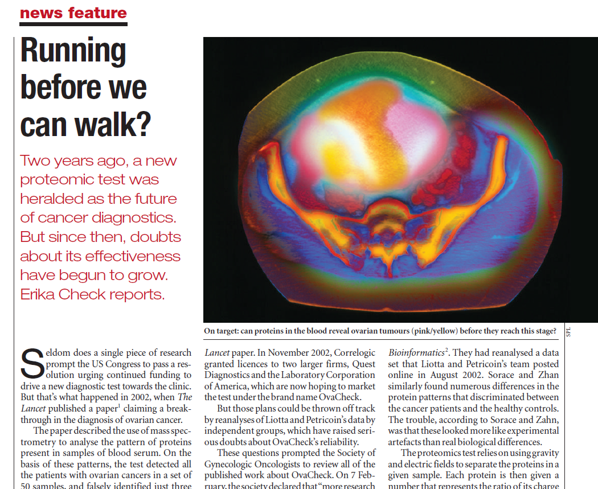
Check E., Proteomics and cancer: running before we can walk? Nature. 2004 Jun 3;429(6991):496-7.

Slide 11
Example: OvaCheck
Developed by Correlogic (www.correlogic.com)
Blood test for the early detection of epithelial ovarian cancer
Failed to obtain FDA approval
Looks for subtle changes in patterns among the tens of thousands of proteins, protein fragments and metabolites in the blood
Signature developed by genetic algorithm
Significant artifacts in data collection & analysis questioned validity of the signature:
Results are not reproducible
Data collected differently for different groups of patients
http://www.nature.com/nature/journal/v429/n6991/full/429496a.html

Slide 12
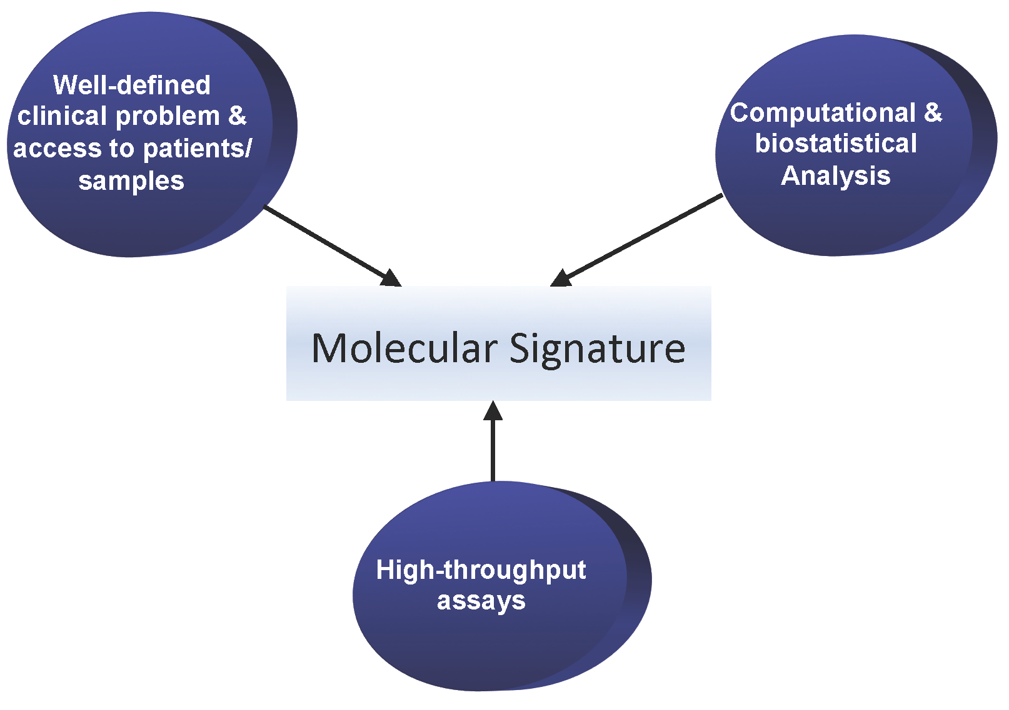
Main ingredients for developing
a molecular signature

Slide 13
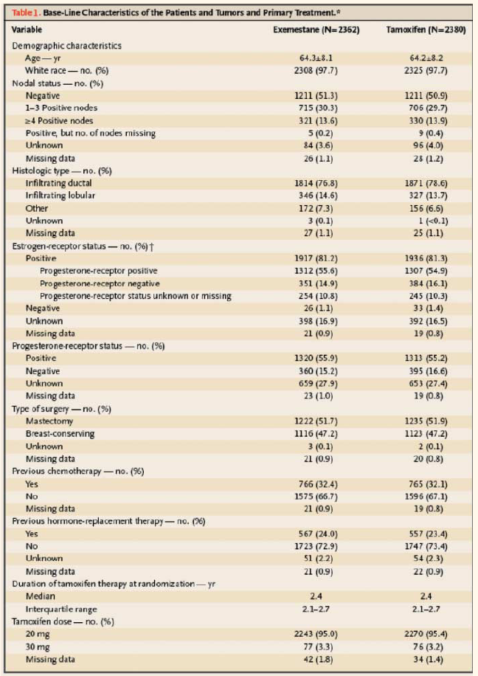
Base-Line Characteristics
DF Ransohoff, "Bias as a threat to the validity of cancer molecular-marker research", Nat Rev Cancer 5 (2005) 142-9.

Slide 14
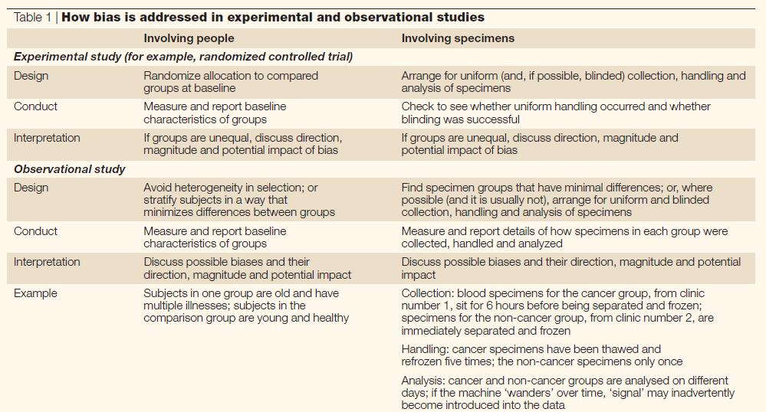
How to Address Bias
DF Ransohoff, "Bias as a threat to the validity of cancer molecular-marker research", Nat Rev Cancer 5 (2005) 142-9.

Slide 15

Principles and geometric representation
for supervised learning
Want to classify objects as boats and houses.

Slide 16
Principles and geometric representation
for supervised learning
All objects before the coast line are boats and all objects after the coast line are houses.
Coast line serves as a decision surface that separates two classes.

Slide 17
Principles and geometric representation
for supervised learning
Longitude
Boat
House
Latitude

Slide 18
Principles and geometric representation
for supervised learning
Longitude
Boat
House
Latitude
Then the algorithm seeks to find a decision surface that separates classes of objects

Slide 19
Principles and geometric representation
for supervised learning
Longitude
These objects are classified as houses
?
?
?
?
?
?
These objects are classified as boats
Latitude
Unseen (new) objects are classified as “boats” if they fall below the decision surface and as “houses” if the fall above it

Slide 20


Principles and geometric representation
for supervised learning
These boats will be misclassified as houses
This house will be misclassified as boat

Slide 21
In 2-D this looks simple but what happens in higher dimensional data…
10,000-50,000 (gene expression microarrays, aCGH, and early SNP arrays)
>500,000 (tiled microarrays, SNP arrays)
10,000-1,000,000 (MS based proteomics)
>100,000,000 (next-generation sequencing)
This is the ‘curse of dimensionality’

Slide 22
High-dimensionality (especially with small samples) causes:
Some methods do not run at all (classical regression)
Some methods give bad results (KNN, Decision trees)
Very slow analysis
Very expensive/cumbersome clinical application
Tends to “overfit”

Slide 23
Two problems: Over-fitting & Under-fitting
Over-fitting (a model to your data) = building a model that is good in original data but fails to generalize well to new/unseen data.
Under-fitting (a model to your data) = building a model that is poor in both original data and new/unseen data.

Slide 24
Over/under-fitting are related to complexity of the decision surface and how well the training data is fit

Slide 25
Over/under-fitting are related to complexity of the decision surface and how well the training data is fit
Outcome of Interest Y
This line is good!
This line overfits!
Training Data
Future Data
Predictor X

Slide 26
Over/under-fitting are related to complexity of the decision surface and how well the training data is fit
Outcome of Interest Y
This line is good!
This line underfits!
Training Data
Future Data
Predictor X

Slide 27
Successful data analysis methods balance training data fit with complexity
Too complex signature (to fit training data well) ➔overfitting (i.e., signature does not generalize)
Too simplistic signature (to avoid overfitting) ➔ underfitting (will generalize but the fit to both the training and future data will be low and predictive performance small).

Slide 28
Challenges in computational analysis of omics data
Relatively easy to develop a predictive model and even easier to believe that a model is when it is not.
There are both practical and theoretical problems.
Omics data has many special characteristics and it is difficult to analyze.
Example: OvaCheck, a blood test for early detection of epithelial ovarian cance, failed FDA approval.
- Looks for subtle changes in patterns of proteins levels
– Signature developed by genetic algorithm
- Data collected differently for the different patient groups

Slide 29
The Support Vector Machine (SVM) approach for building molecular signatures
Support vector machines (SVMs) is a binary classification algorithm.
SVMs are important because of (a) theoretical reasons:
Robust to very large number of variables and small samples
Can learn both simple and highly complex classification models
Employ sophisticated mathematical principles to avoid overfitting
and (b) superior empirical results.

Slide 30
The Support Vector Machine (SVM) approach for building molecular signatures
Gene Y
Normal patients
Cancer patients
Gene X
Consider example dataset described by 2 genes, gene X and gene Y
Represent patients geometrically (by “vectors”)

Slide 31
The Support Vector Machine (SVM) approach for building molecular signatures
Gene Y
Gap
Normal patients
Cancer patients
Gene X
Find a linear decision surface (“hyperplane”) that can separate patient classes and has the largest distance (i.e., largest “gap” or “margin”) between border-line patients (i.e., “support vectors”);

Slide 32
The Support Vector Machine (SVM) approach for building molecular signatures
If such linear decision surface does not exist, the data is mapped into a much higher dimensional space (“feature space”) where the separating decision surface is found;
The feature space is constructed via very clever mathematical projection (“kernel trick”).

Slide 33
Estimation of signature accuracy
data
test
Large sample case:
use hold-out validation
train
data
train
test
train
train
train
train
train
test
Small sample case: use N-fold cross-validation
test
test
test
test

Slide 34
Challenges in computational analysis of omics data for development of molecular signatures
Signature multiplicity (Rashomon effect)
Poor experimental design
Is there predictive signal?
Assay validity/reproducibility
Efficiency (Statistical and computational)
Causality vs predictivness
Methods development (reinventing the wheel)
Many variables, few samples, noise, artifacts
Editorialization/Over-simplification/Sensationalism

Slide 35
General conclusions
Molecular signatures play a crucial role in personalized medicine and translational bioinformatics.
Molecular signatures are being used to treat patients today, not in the future.
Development of accurate molecular signature should rely on use of supervised methods.
In general, there are many challenges for computational analysis of omics data for development of molecular signatures.
One of these challenges is molecular signature multiplicity.
There exist an algorithm that can extract the set of maximally predictive and non-redundant molecular signatures from high-throughput data.

Slide 36
Proteomics Informatics –
Molecular signatures (Week 12)

